Slide 1

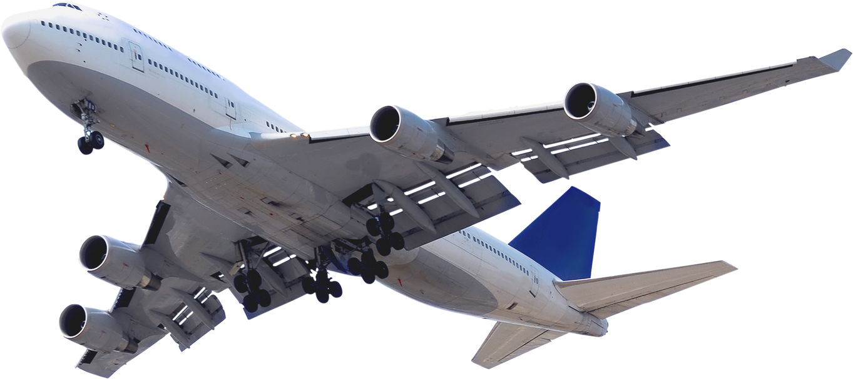




Slide 2



BACKGROUND
AND
OBJECTIVES
Background
What factors correlate with airline passenger dissatisfaction?
Objectives
What machine learning model has the best performance for predicting airline passenger satisfaction?
What recommendations can be given to the business team aimed at improving airline passenger satisfaction?

Slide 3
DATA UNDERSTANDING
13 Columns
Understand the data type
of each column
Understand the description and data content
of each dataset column.
103.904 Rows
No. | Column Name | Description | Type Data | Fill in the data
1. | ID | Passenger's unique ID | categoricall | -
2. | Gender | Passanger type | categorical | Female, Male
3. | Customer_type | Passanger/customer type | categorical | Loyal customer, Disloyal Customer
4. | Age | Age of passanger | numerical | Min: 7 yo, Max: 85yo
5. | Flight_Distance | Customer flight distance | numerical | Min: 31 km, Max: 4983 km
6. | Class | Customer flight class | categorical | Eco, Eco Plus, Business
- | - | - | -
- | - | - | -
25. | satisfaction | Passanger satisfaction level | categorical | neutral or dissatisfied, satisfied
FEATURES

Slide 4
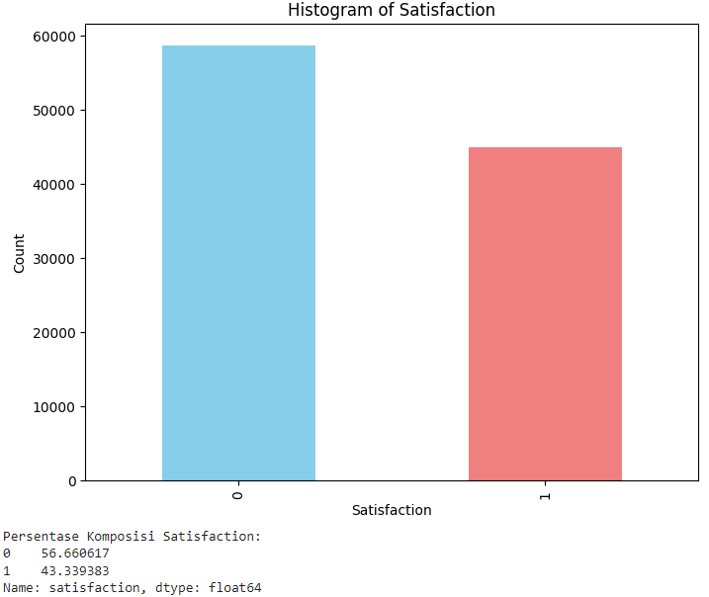
EXPLORATORY DATA ANALYSIS
The target variable, specifically denoted as "satisfaction,"
is composed of the following:
56,67%
43,33%
represents those who are neutral or dissatisfied
represents those who are satisfied
This indicates that the data remains relatively balanced.

Slide 5
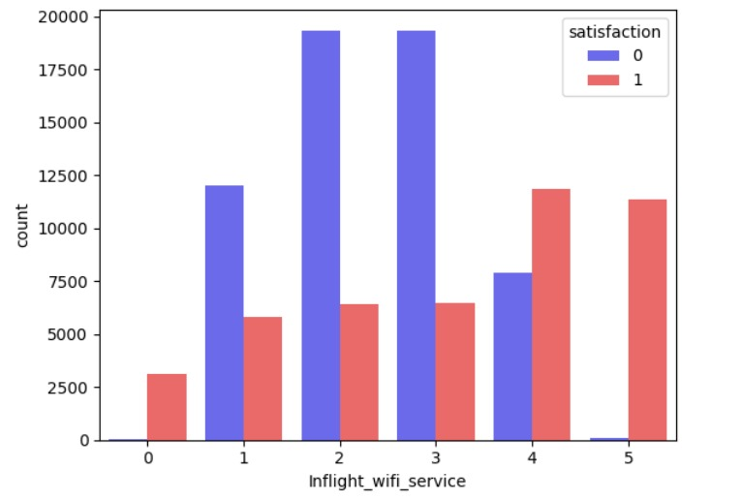
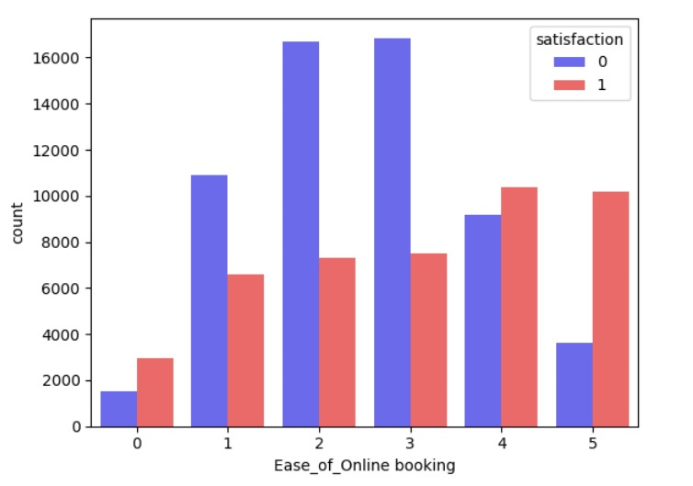
EXPLORATORY DATA ANALYSIS
In the Inflight_wifi_service and Ease_of_Online booking features, the majority of passengers expressed dissatisfaction rather than satisfaction.

Slide 6
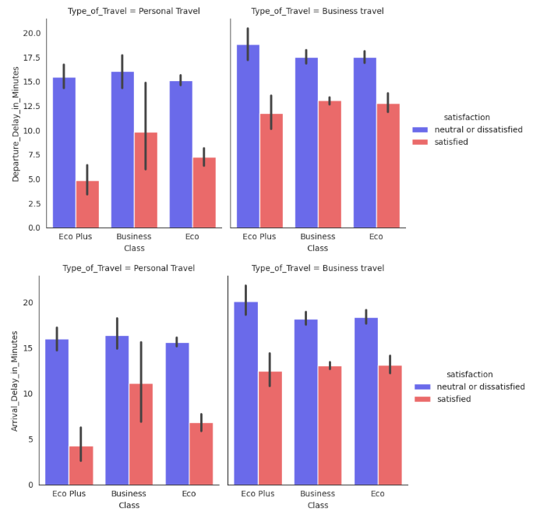
EXPLORATORY DATA ANALYSIS
Departure and Arrival Delay
All class flight types and passenger types show results that tend to be dissatisfied rather than satisfied with delays.
The longer the delay happens, the more dissatisfied the passengers are.

Slide 7
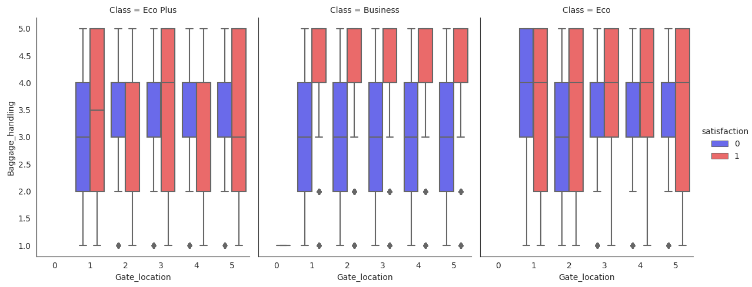
EXPLORATORY DATA ANALYSIS
Passengers on every class of flight, regardless of gate location, were dissatisfied with inadequate baggage handling.

Slide 8
DATA PREPROCESSING
Check Misising Values.
After the Missing Values were carried out, there were 310 Missing Values in the 'Arrival_Delay_in_Minutes' column and it was decided to drop them.
The Encoder label for each column is of categorical type
3
1
Create a Min-Max Scalar for numeric columns.
4
Drop the 'Unnamed: 0' and 'id' columns because they are not needed for the modeling process.
2
Create a correlation data heatmap to check multicollinearity.
5

Slide 9
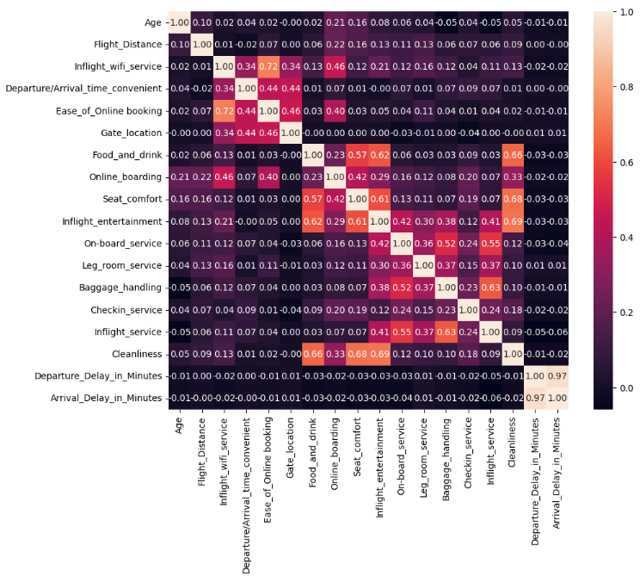
DATA
PREPROCESSING
There is a multicollinearity between 'Arrival_Delay_in_Minutes' and 'Departure_Delay_in_Minutes' but it is not dropped because these two variables affect the level of passenger satisfaction.

Slide 10
MODELLING AND EVALUATION
Utilized modeling consists of the following varieties:
In the modeling stage,it breaks down the data into 2 (two) datasets:
K-NEAREST NEIGHBOUR (KNN)
LOGISTIC REGRESSION
Data train amounted to 70% of the total
70%
30%
Test data amounted to 30% of the total
SUPPORT VECTOR MACHINES (SVM)
RANDOM FOREST

Slide 11


MODELLING AND EVALUATION
Model Classifier | Accuracy Ratio | F1 Score
KNN | 92.58% | 91.1%
Logistic Regression | 87.16% | 84.9%
Random Forest | 96.23% | 95.5%
SVM | 94.4% | 93.4%
The best recommended model is
Random Forest

Slide 12
CONCLUSION
In terms of overall passenger satisfaction and experience, 56.67% of them were neutral or dissatisfied, and 43.33% were satisfied.
Most passengers showed high dissatisfaction with the features of Wi-Fi service during flights and the ease of online booking. It's interesting because the availability of Wi-Fi is not a basic necessity on a flight.
All kinds of passengers from all types of flight classes showed dissatisfaction over inadequate luggage handling and long waiting times for flight delays.
The best machine learning model is Random Forest, with an accuracy ratio of 96.23% and an F1 score of 95.5%.

Slide 13
RECOMMENDATION
There are some features that cause passenger dissatisfaction that tend to be high. Decision-makers should consider the following recommendations:
Although it is not a basic requirement in flight, it turns out that an adequate Wi-Fi experience is important for most passengers. Decision-makers should consider adding Wi-Fi operating costs and adequate management. If the cost increase is not possible, then it can also be done by providing certain substitute entertainment.
The simplicity of online booking is critical in the digital age, which demands high mobility as well as the requirement to transact swiftly and securely. Companies can work with third parties, such as travel applications, to improve online ticket booking systems.
To ensure proper handling, SOP officers must supervise and perform quality baggage handling.
Decision-makers can optimize efforts to reduce elements under the airline's control that can cause extended delays in departure or arrival.
In addition to the above four features, other features also require research and improvement so that the company can create a pleasant experience for airline customers.

Slide 14

THANK YOU
Please kindly hit me up on
Linked In:
http://www.linkedin.com/in/fadzal26

